Slide 1
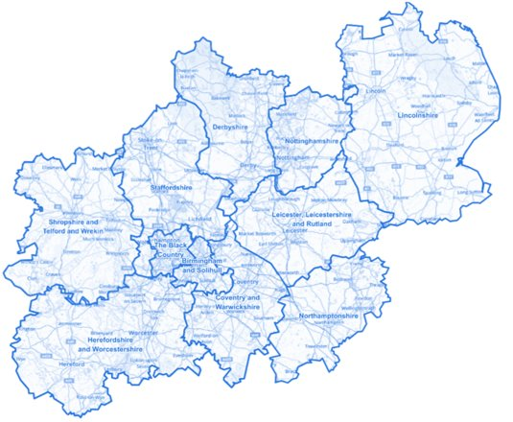
Organisational Development for our Midlands Systems
What is OD ?
Organisational Development – is the application of behavioural science to support growth, align strategy and capability, for individuals, teams, organisations and systems.
How do we do it ?
Using tools and techniques from a wide range of disciplines e.g. psychology, anthropology, sociology, economics, to facilitate movements of groups and organisations.
What is the Impact of OD?
It enhances collective capability to improve people’s experiences. OD promotes a people focus at the heart of delivering organisational and system objectives, making the workplace a great place to be.

